Slide 1
Using Spark for crunching astronomical data on the LSST scale
Petar Zečević
SV Group
University of Zagreb
DiRAC Institute @ University of Washington

Slide 2
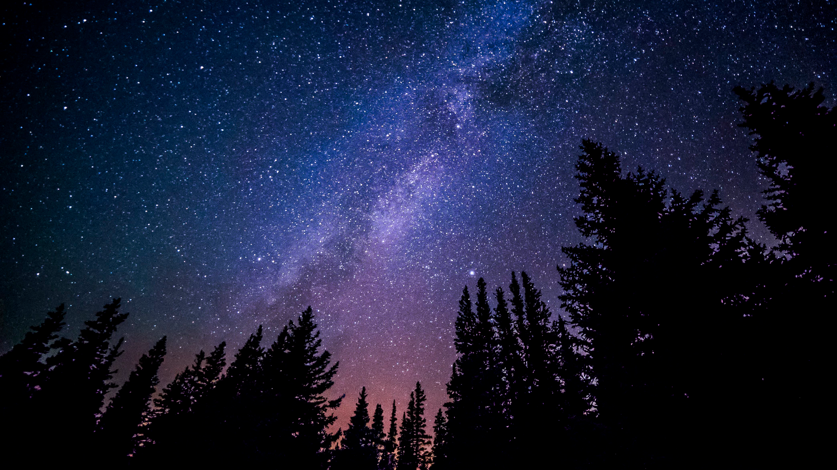
About me
CTO at SV Group, Zagreb, Croatia
PhD (CS) student at University of Zagreb
Visiting fellow at DiRAC institute, University of Washington

Slide 3
About me
Author of
Spark in Action
P.S.: Ping me if you
need a Spark course
for your team !

Slide 4
How did it start ?
What is it made of ?
Are we alone ?
What is its future ?
Notes:
The sky is just fascinating. It has been fascinating us for thousands of years. And it is still quite mysterious.
How did it start? What is it made of? What is its future? Are we alone?

Slide 5
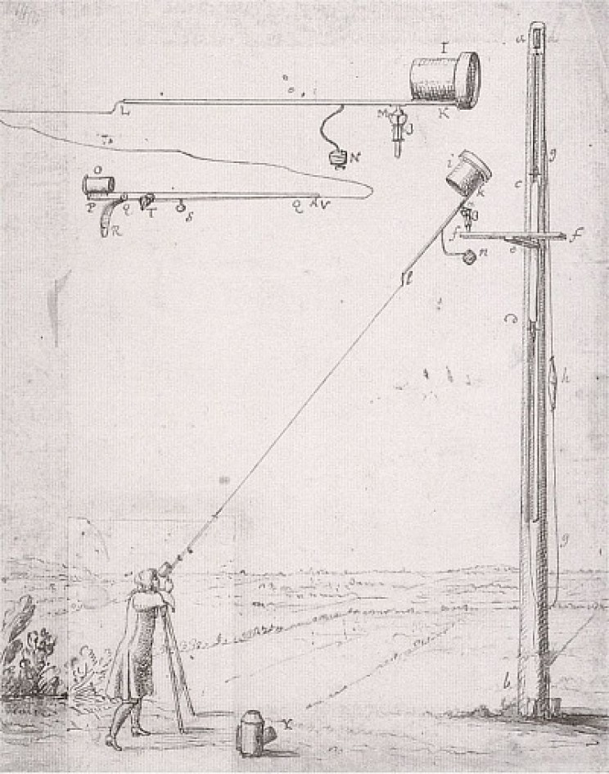
Notes:
The begginings were humble (Christian Huygens)

Slide 6
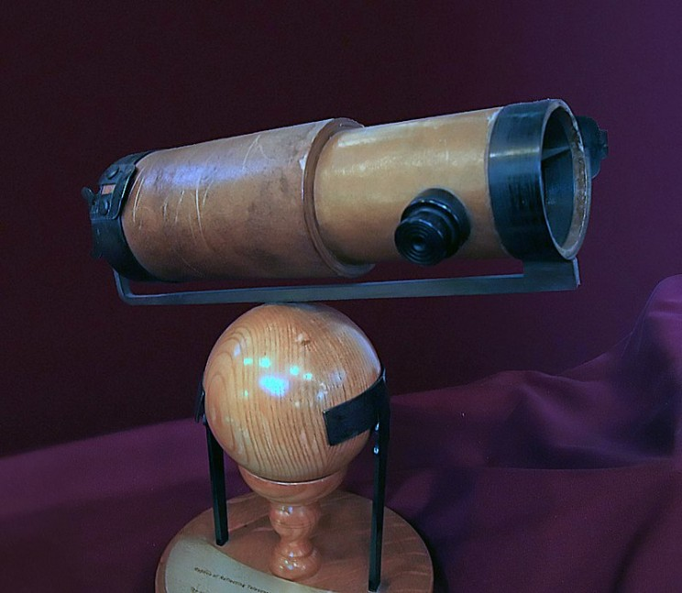
Notes:
Newton's telescope.

Slide 7
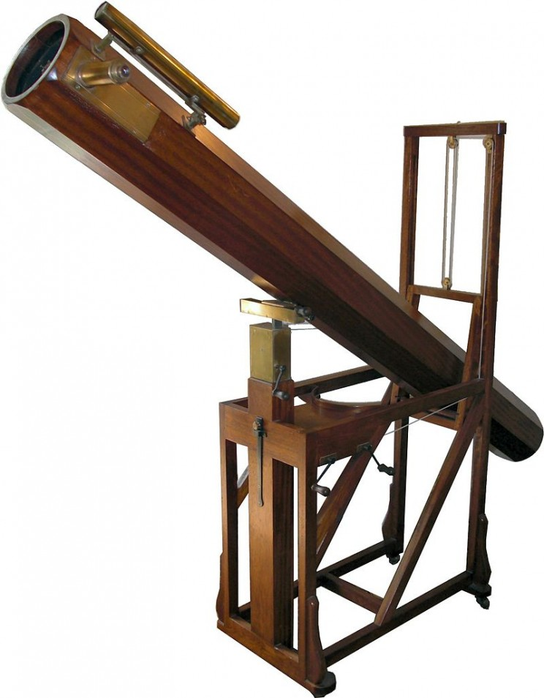
Notes:
They built larger and larger telescopes, during 17th and 18th centuries.

Slide 8
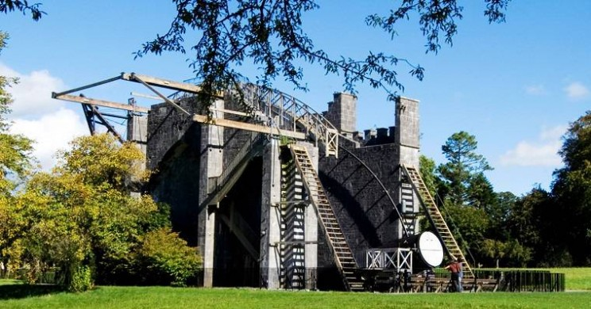
Notes:
The sky is just fascinating.

Slide 9
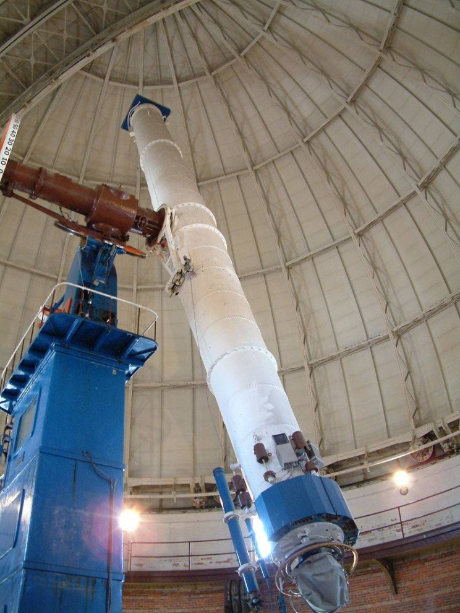
Notes:
The sky is just fascinating.

Slide 10
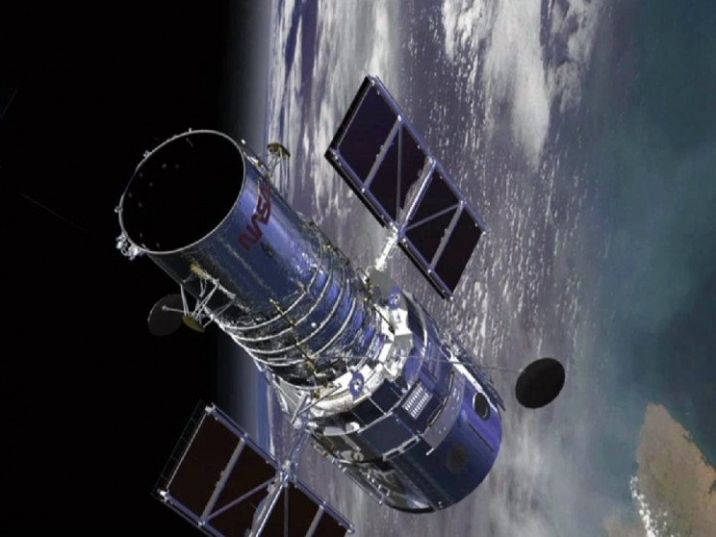
Notes:
The sky is just fascinating.

Slide 11
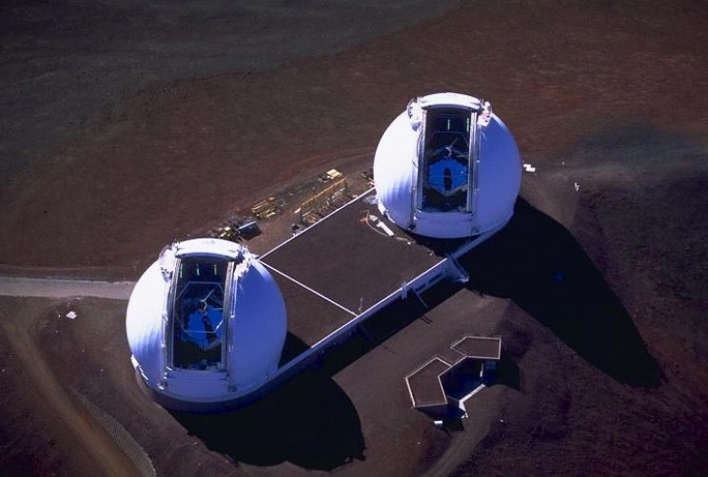
Notes:
Keck Observatory

Slide 12
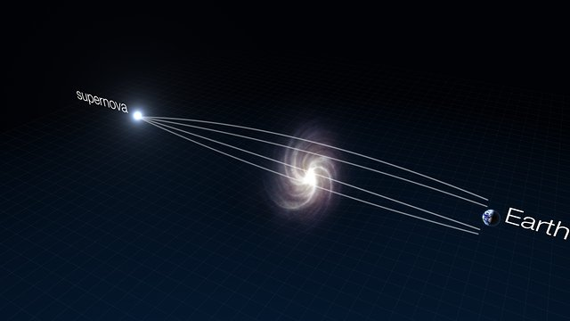
Strong lensing
Einstein ring
Notes:
This was so fascinating to me when I frist learned about this. How many of you know what this is?

Slide 13
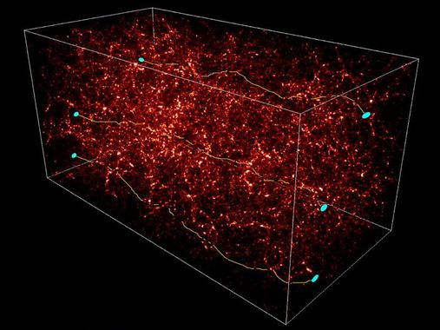
Weak lensing
Notes:
Similar to patterns of light at the bottom of a pool. These effects are really small and you need very accurate measurements to estimate weak lensing effects. And for that you need bigger telescopes.

Slide 14
Enter LSST
Large Scale Survey Telescope
It is “wide” and “deep”
Largest camera in the world
Will continuously observe the night sky during 10 years
Produce the first “video of the Universe” in history
To start full science operations in 2023
Notes:
One of those future big telescopes is LSST. Unique in several aspects.

Slide 15
LSST's goals
What are dark matter and dark energy?
Make a catalogue of solar system objects, including potentially dangerous asteroids
Track transients (alerts)
Study structure and formation of the Milky Way
Notes:
If an asteroid moves, that's a transient. If a supernova explodes, that's a transient too.

Slide 16
LSST - a very expensive instrument
Notes:
Very expensive data collection instrument. A large building will be housing the 350-ton telescope. Only the dome is 30m wide.

Slide 17
LSST - a very expensive instrument

Slide 18
LSST - a very expensive instrument
Notes:
8.4m primary/terciary mirror

Slide 19
LSST - a very expensive instrument
3.2 Gpixel images
6.4 GB (1500 HD TVs)
A new image every 20 s
Notes:
The biggest camera in the world. 3.2 Gpixels. One image is 6.4 GB. You would need 1500 HD TVs to show a single image

Slide 20
LSST - a very expensive instrument
Notes:
Dedicated optical lines

Slide 21
LSST in numbers
Metric | Amount
Number of detections | 7 trillion
Number of objects | 37 billion
Nightly alert rate | 10 million
Nightly data rate | 15 TB
Alert latency | 60 seconds
Total images after 10 yrs | 50 PB
Total data after 10 yrs | 83 PB
Stored in a queryable catalog

Slide 22
Astronomical catalogs
Just (big!) databases
Each row corresponds to a detection or an object (star/galaxy/asteroid)
Producing catalogs from images is not trivial - non-exhaustive list of problems (for software to solve):
background estimation
PSF estimation
object detection
image co-addition
deblending

Slide 23
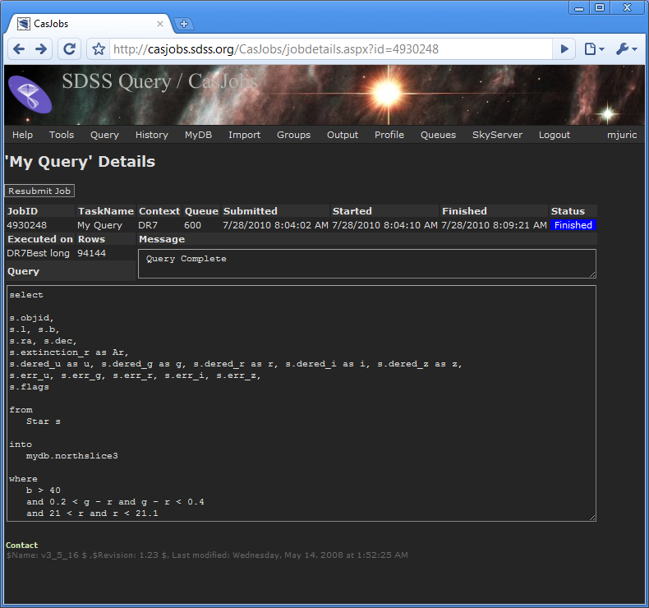
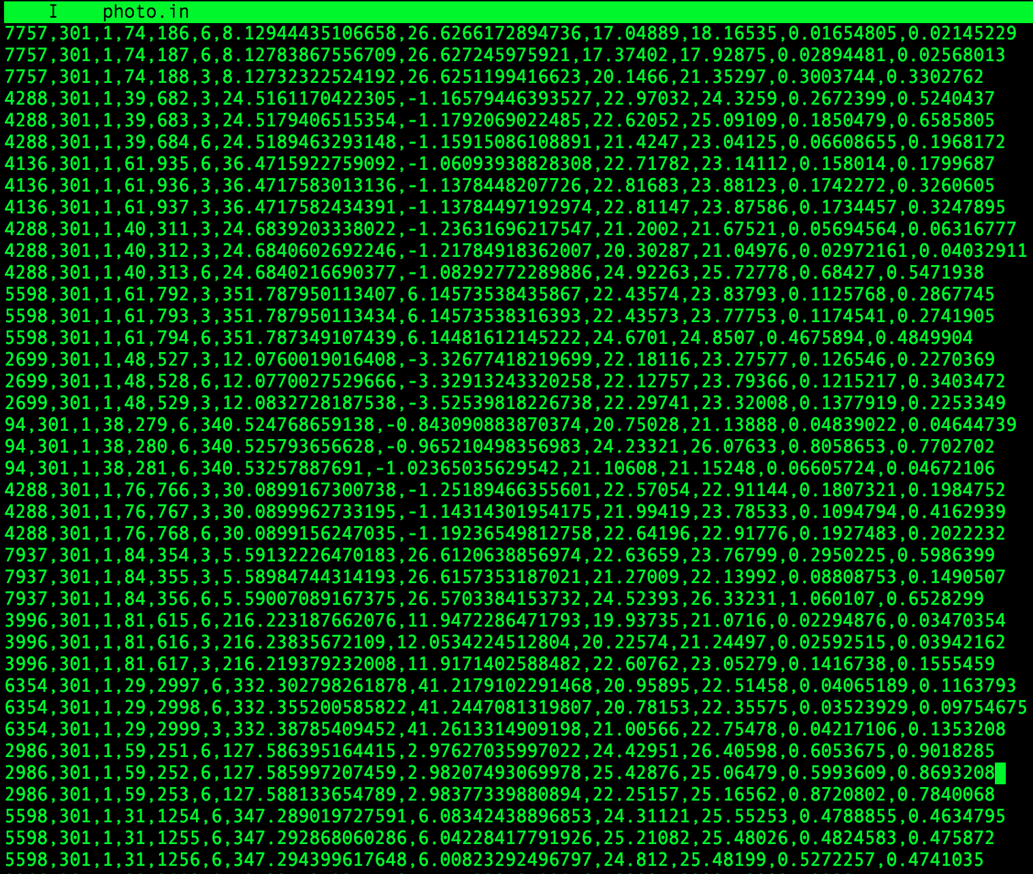
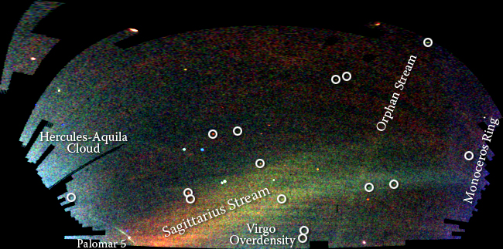
Science based on catalogs
Once a catalog is available, astronomers “ask” all kinds of questions
The traditional paradigm:
Subset (filter data using a catalog SQL interface online)
Download data locally
Analyze (usually Python)

Slide 24
Traditional doesn't scale well
LSST will provide a “cloud service” called LSST Science Platform for analyzing the data using Jupyter notebooks and other tools (bringing the code to the data)
However, astronomers often want to:
Combine multiple catalogs (cross-match them)
Work on the full dataset

Slide 25
Enter AXS
Astronomy eXtensions for Spark
DiRAC institute @ UW saw the need for next generation astronomical analysis tool
Efficient cross-matching
Based on industry standards (Apache Spark)
Provides simple (but powerful) astronomical API extensions
Easy to use on-premises or in the cloud

Slide 26
AXS history: LSD by Mario Jurić
Tool for querying, cross-matching and analysis of positionally or temporally indexed datasets
Inspired by Google's BigTable and MapReduce papers
However it has some shortcomings:
Fixed data partitioning (significant data skew)
Time-partitioning problematic (most queries do not slice by time)
Not resilient to worker failures
Contains a lot of custom solutions for functionalities that are common today

Slide 27
Cross-matching of two catalogs
A match
Search perimeter
(can also use similarity)
DEC and RA coordinates
Notes:
DEC and RA - coordinate system
The distance can be Euclidian distance or some other measure (e.g. “similarity”).

Slide 28
AXS data partitioning
Data partitioning is at the root of AXS' efficient cross-matching
Based on (late) Jim Gray's “zones algorithm” (Microsoft research)
Sky divided into horizontal “zones” of a certain height
Adapted for distributed architectures
Data stored in Parquet files
bucketed by zone
sorted by zone and ra columns
data from zone borders duplicated to the zone below

Slide 29
AXS data partitioning

Slide 30
AXS - optimal joins

Slide 31
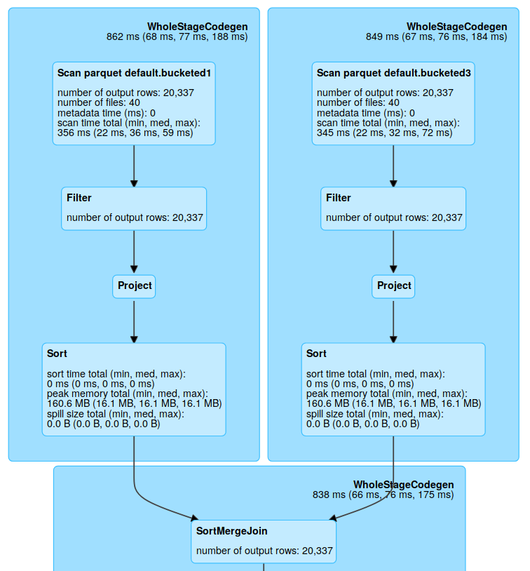
AXS - optimal joins

Slide 32
Epsilon join
SELECT ... FROM TA, TB
WHERE TA.zone = TB.zone
AND TA.ra BETWEEN TB.ra - e AND TB.ra + e
SPARK-24020: Sort-merge join
optimization

Slide 33
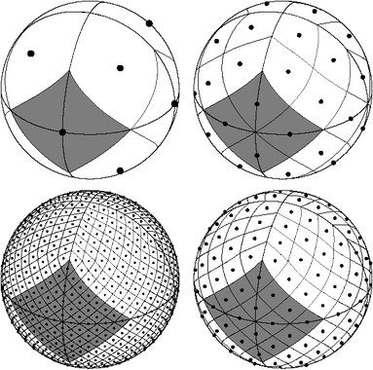
Other aproaches
Other systems use
HEALPix
or Hierarchical Triangular Mesh (HTM)

Slide 34
AXS - Performance results
Gaia (1.7 B) x SDSS (800 M)
37s warm (148s cold)
Gaia (1.7 B) x ZTF (2.9 B)
39s warm (315s cold)
(Tests run on a single large machine)

Slide 35
AXS API

Slide 36
AXS API
Other functionalities:
crossmatch (return all or the first crossmatch candidate)
region queries
cone queries
histogram
histogram2d
Spark array functions for handling lightcurve data
All other Spark functions

Slide 37
AXS next steps
Make AXS cloud ready:
Have pre-partitioned catalogs ready in S3
Run AXS on Kubernetes on-demand
Empower new astronomical discoveries in the 21st century!

Slide 38
Completely off-topic, but btw:
I provide Spark courses. If you need one for your team, ping me @:
petar.zecevic@svgroup.hr
linkedin.com/in/pzecevic
or just stop me when you see me :)

Slide 40
Rate today ’s session
Session page on conference website
O’Reilly Events App

